Slide 1
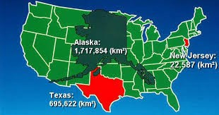
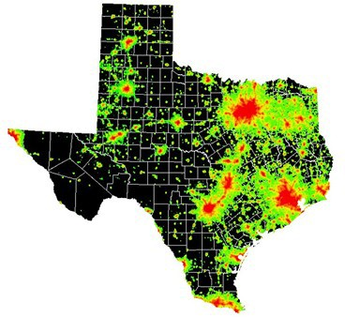
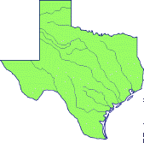
 | Texas Texas is the largest state in the U.S. Only is bigger The total surface area of is square miles. Texas makes up about of the total area of the United States.
 | Texas Cities Houston- The city in Texas & the largest in the . San Antonio- largest in the . Austin- most state capital in the U.S. Other major cities include: Amarillo Fort Worth El Paso Laredo
 | Texas Rivers Rio Grande River- Forms most of Texas’s boundary Red River- Acts as part of the boundary between & Sabine River- Helps form the boundary between & Other major rivers include: River River River River River River

Slide 2
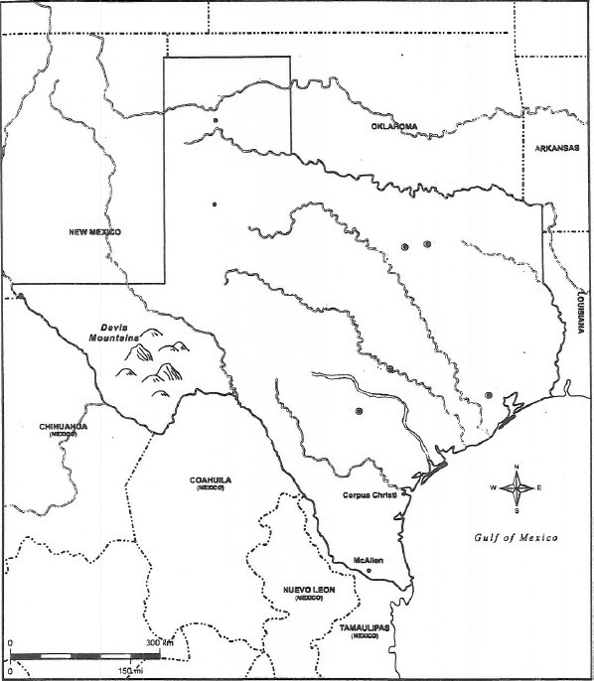
Texas Rivers & Cities
River
City
City
City
City
City
River
River
River
River
City
Houston
River
City
River
River
City
City

