Slide 1
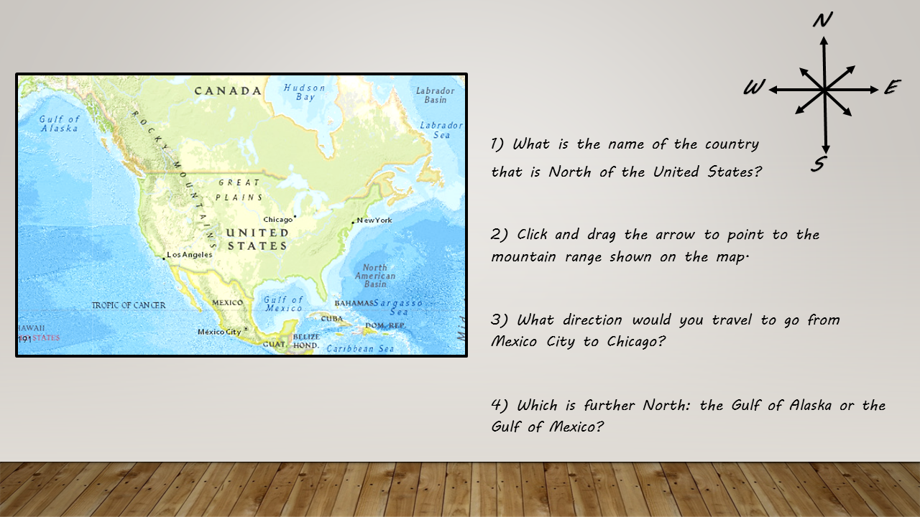
Type Here
Type Here
Type Here

Slide 2
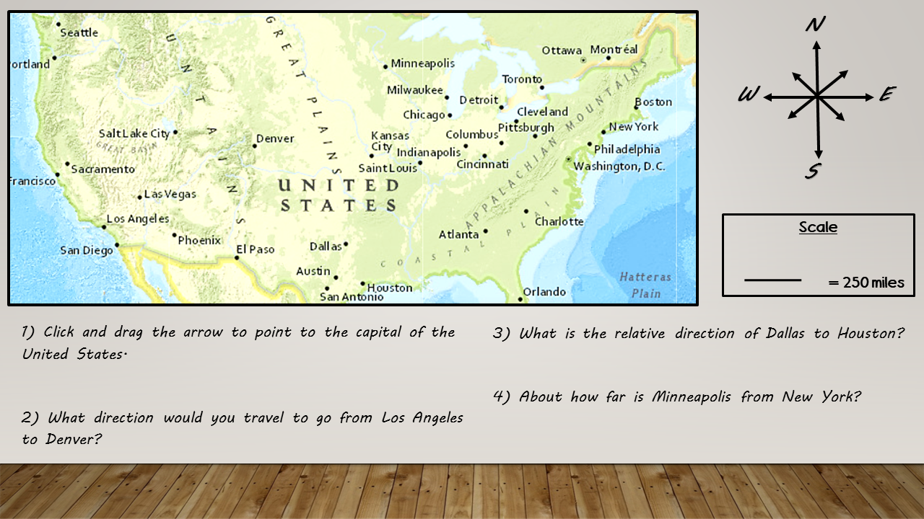
Type Here
Type Here
Type Here

Slide 3
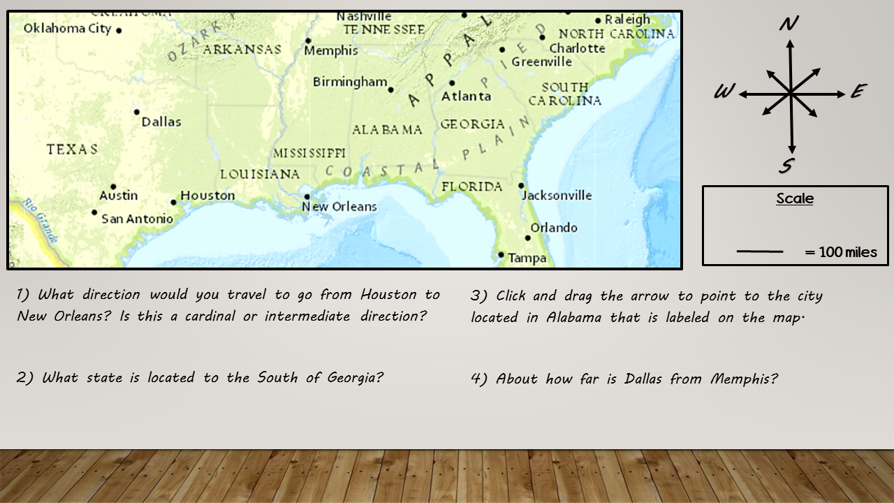
Type Here
Type Here
Type Here

Slide 4
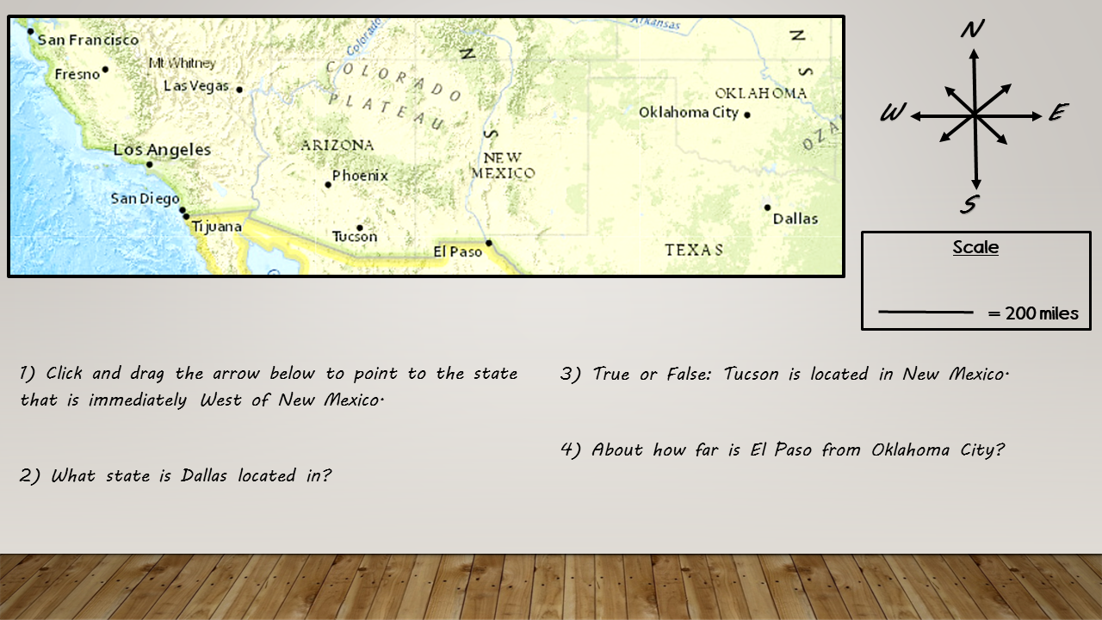
Type Here
Type Here
Type Here

Slide 5
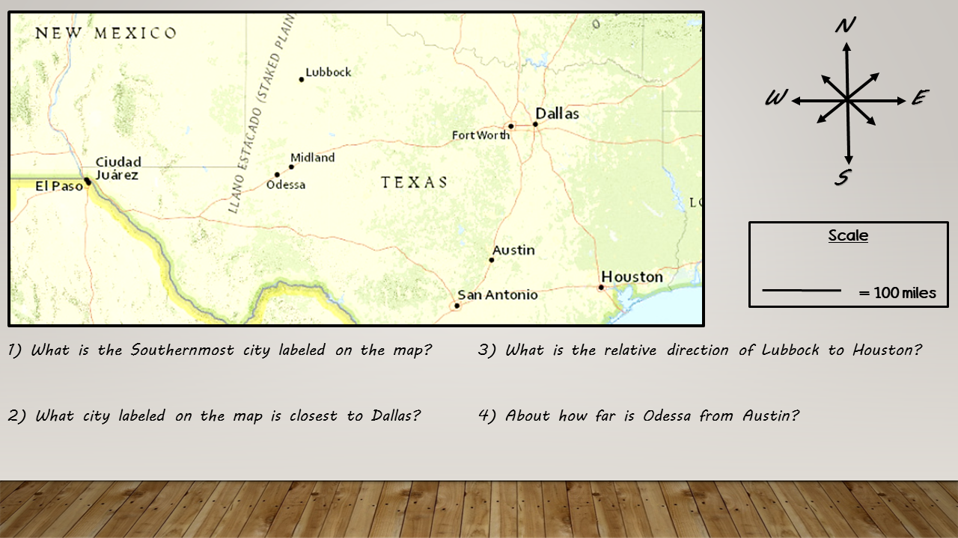
Type Here
Type Here
Type Here
Type Here

