Slide 1
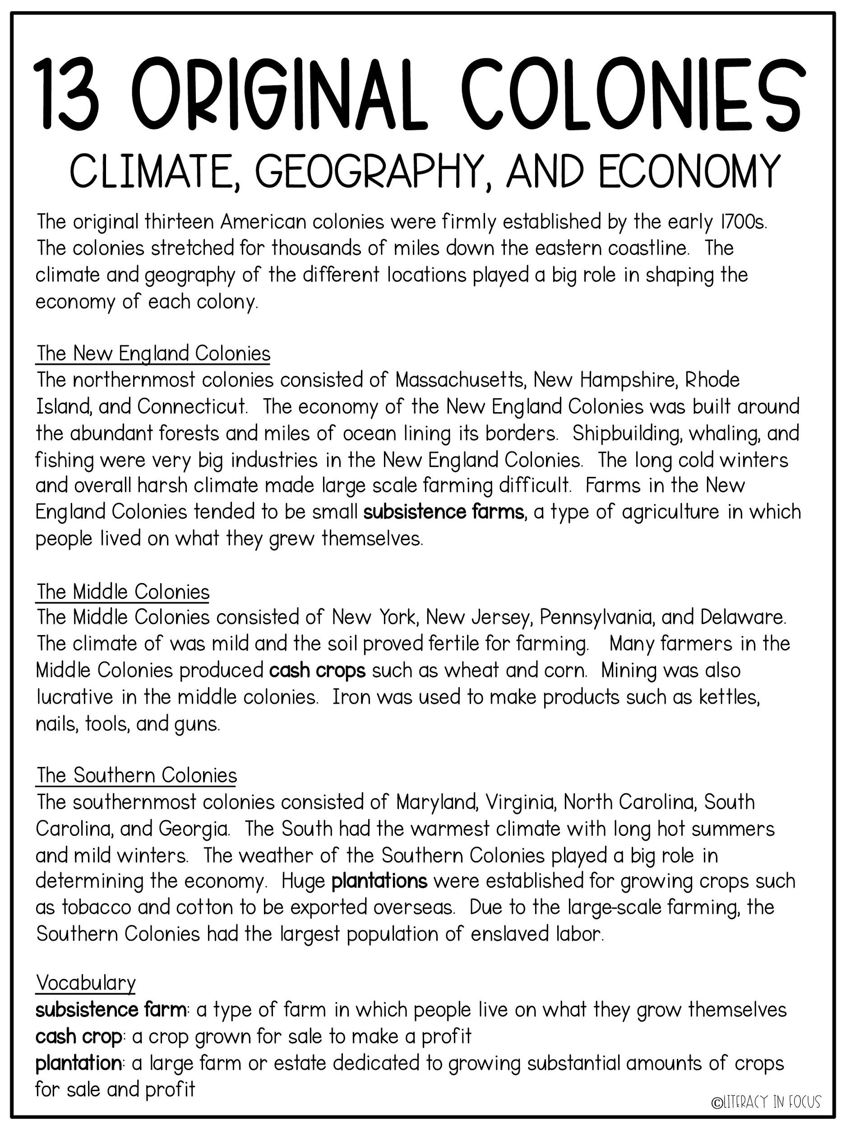

Slide 2
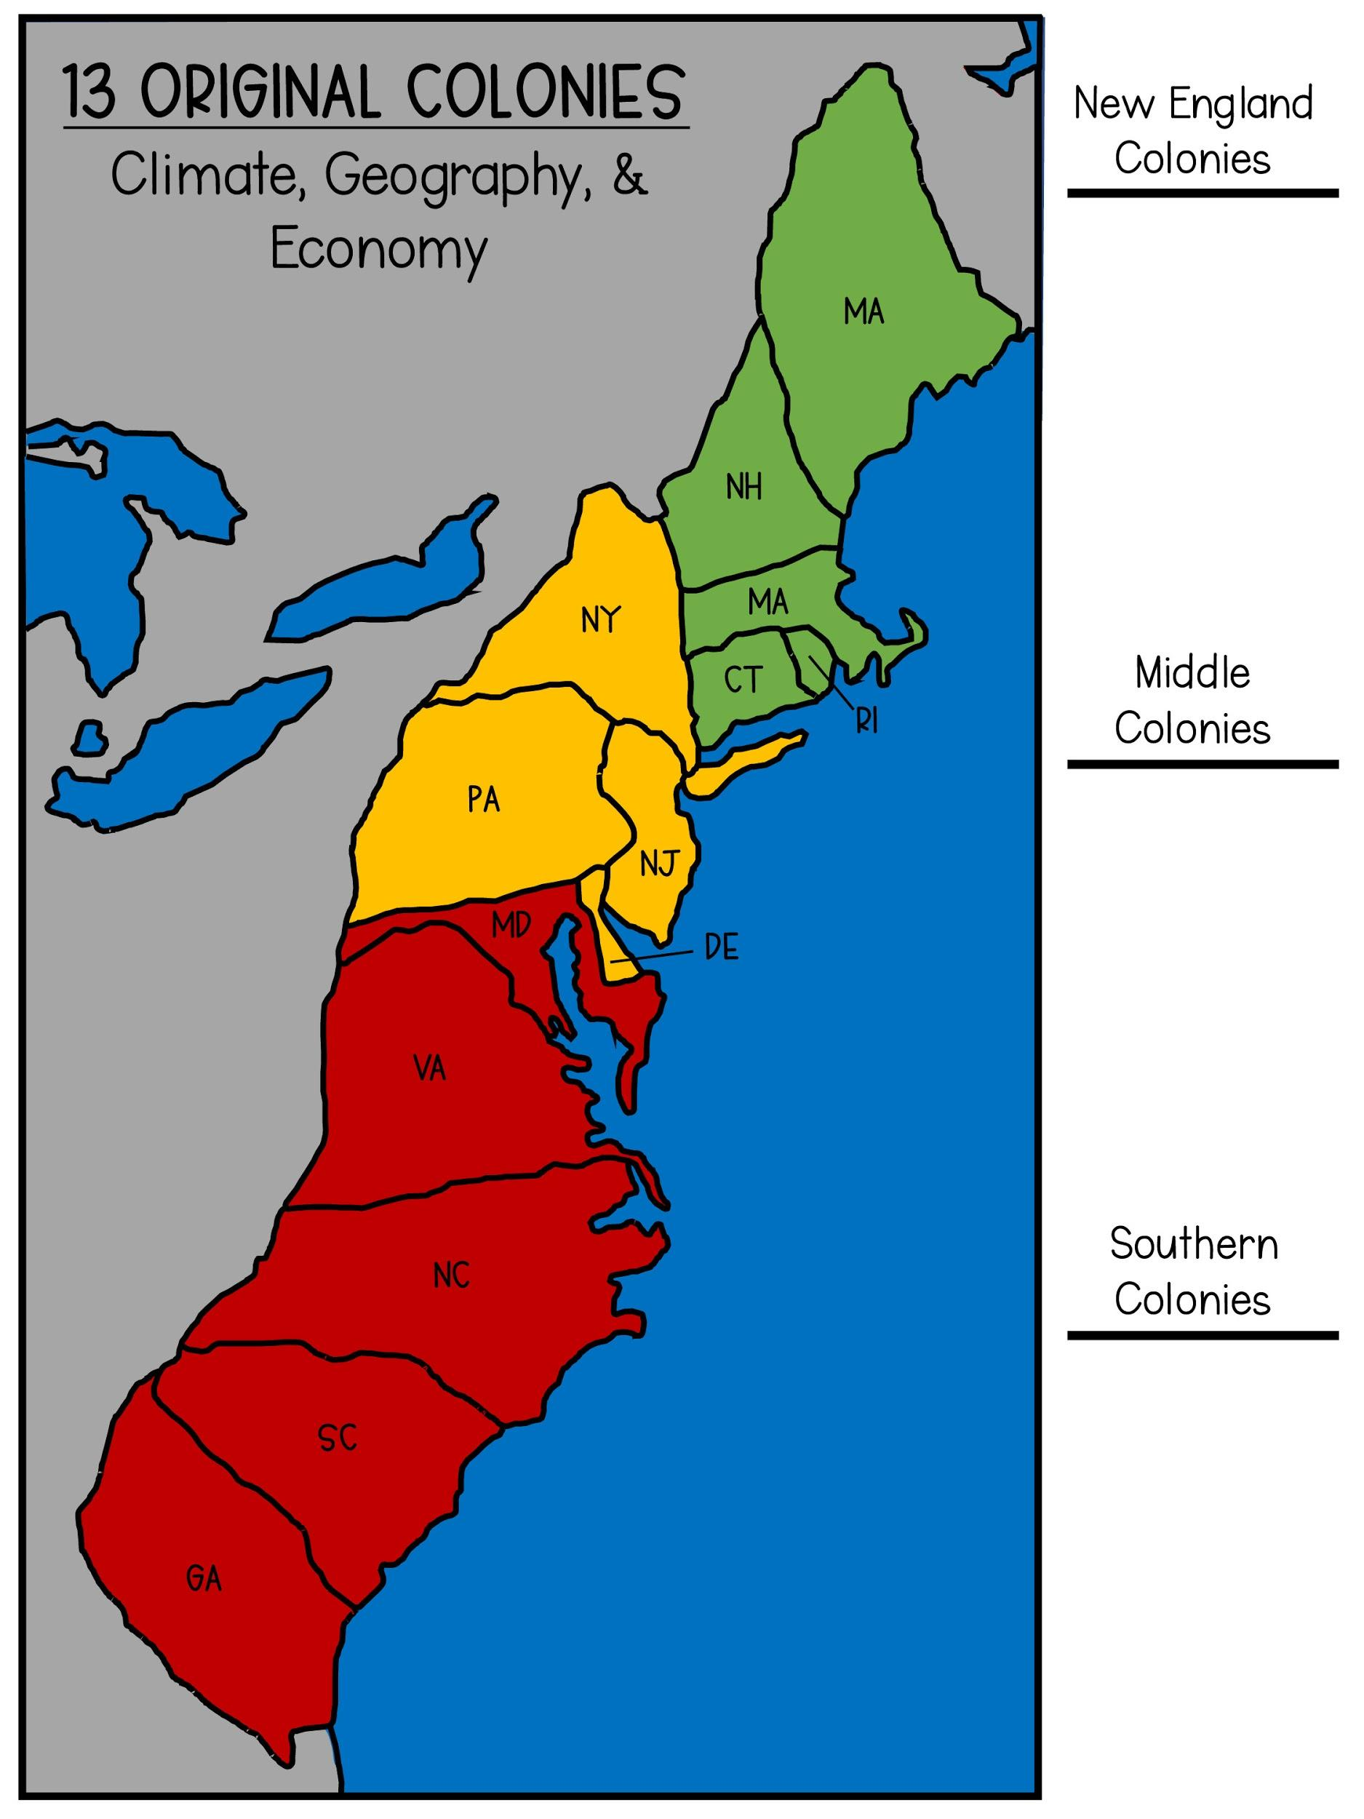
Directions
1. Fill in the colony names (in the colored boxes) for the New England, Middle, and Southern Colonies.
2. Label the Atlantic Ocean
3.
New England Colonies
-Drag & drop the snowflake to represent the harsh winter climate.
-Drag & drop the fish and the tree to represent the economy.
Middle Colonies
-Drag & drop the sun and raindrops to represent the milder climate.
-Drag & drop the small farm and nail to represent the economy.
Southern Colonies
-Drag & drop the sun to represent the climate.
-Drag & drop the crops and chains (enslaved labor) to represent the economy.

Slide 3
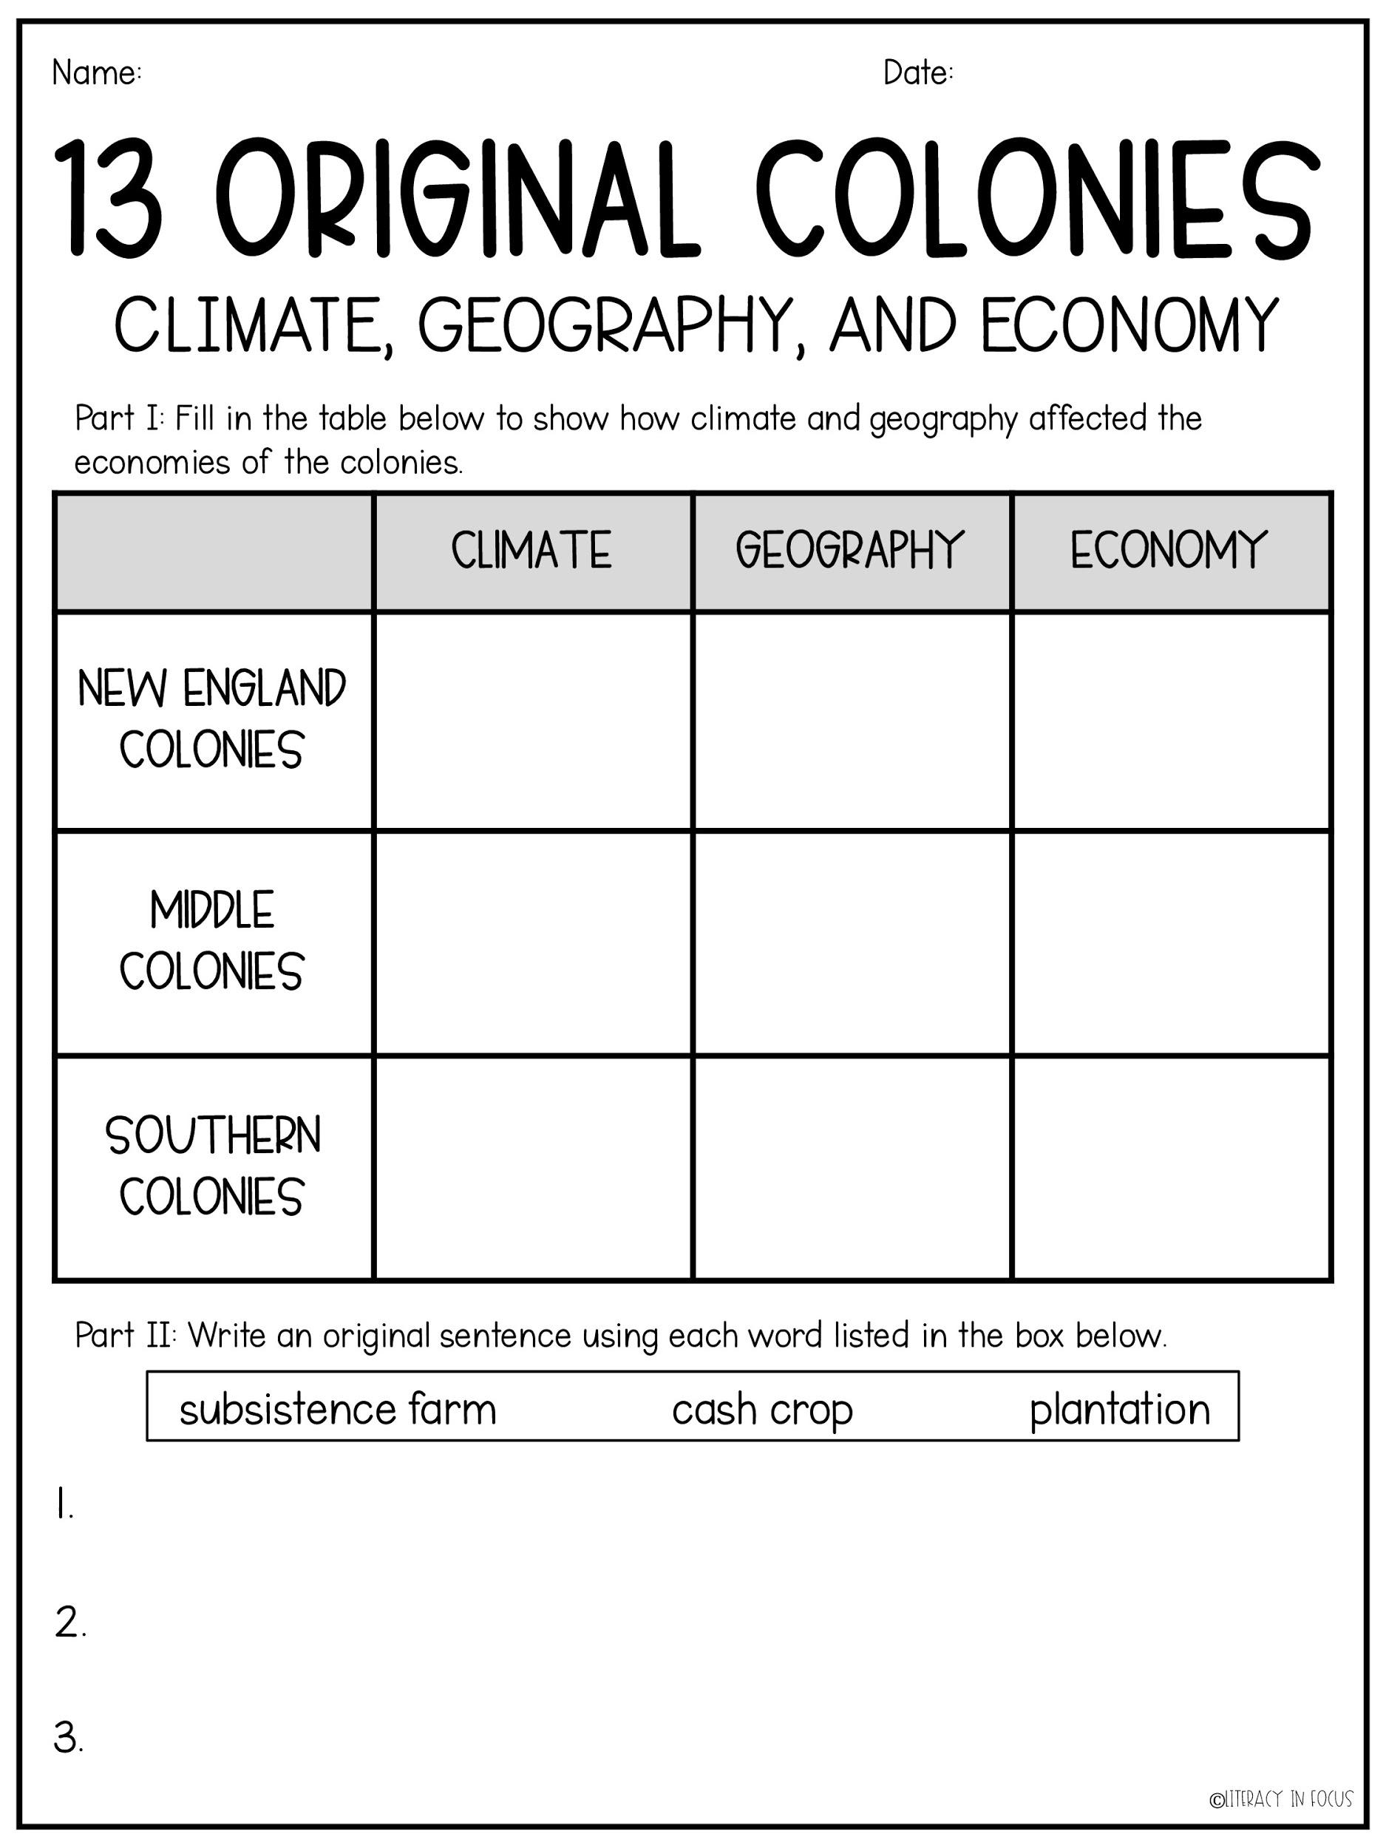

Slide 4
